Slide 1
3.1.4 Struktur des Universums
  Astronomie
  Wahlfach
Cepheidenmethode
E. Malz
ZPG Astronomie

Slide 2
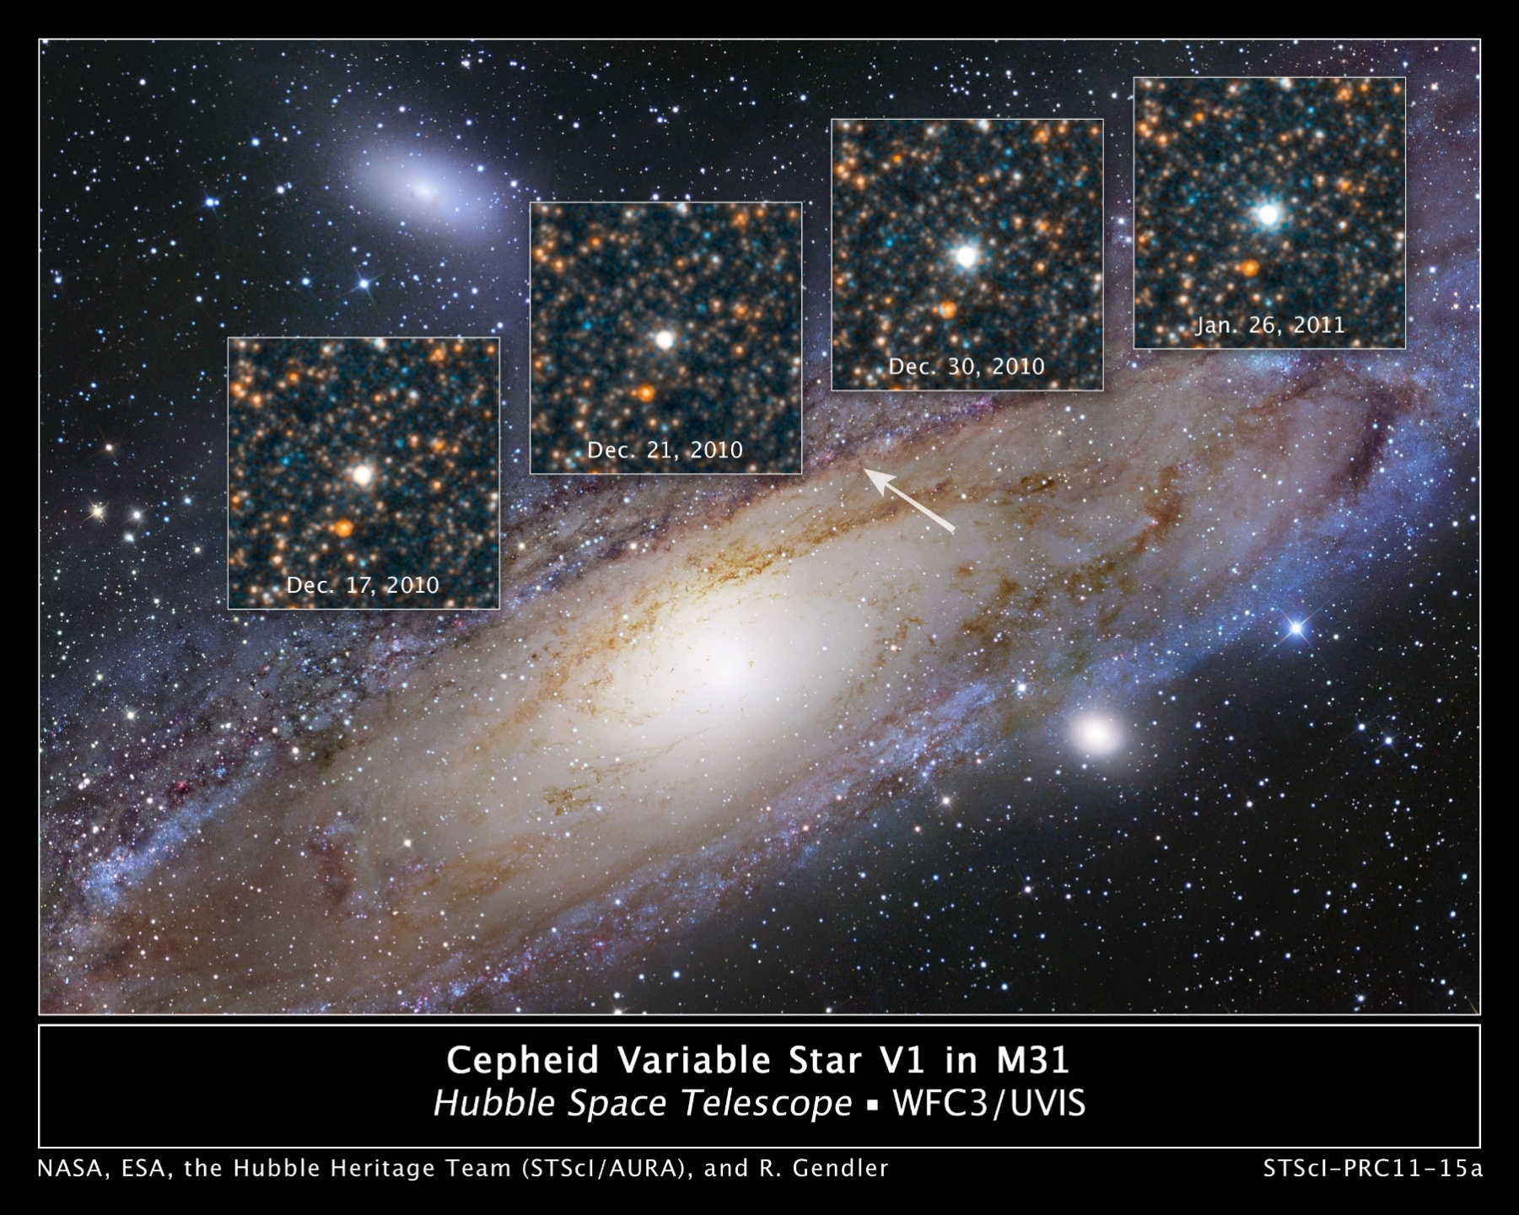
M31
760 kpc
Bild: Cepheid Variable Star V1 in M31 von NASA, ESA, the Hubble Heritage Team (STScl/AURA) and R. Gendler via https://www.nasa.gov/mission_pages/hubble/science/star-v1.html [Public Domain (PD-USGov)]

Slide 3
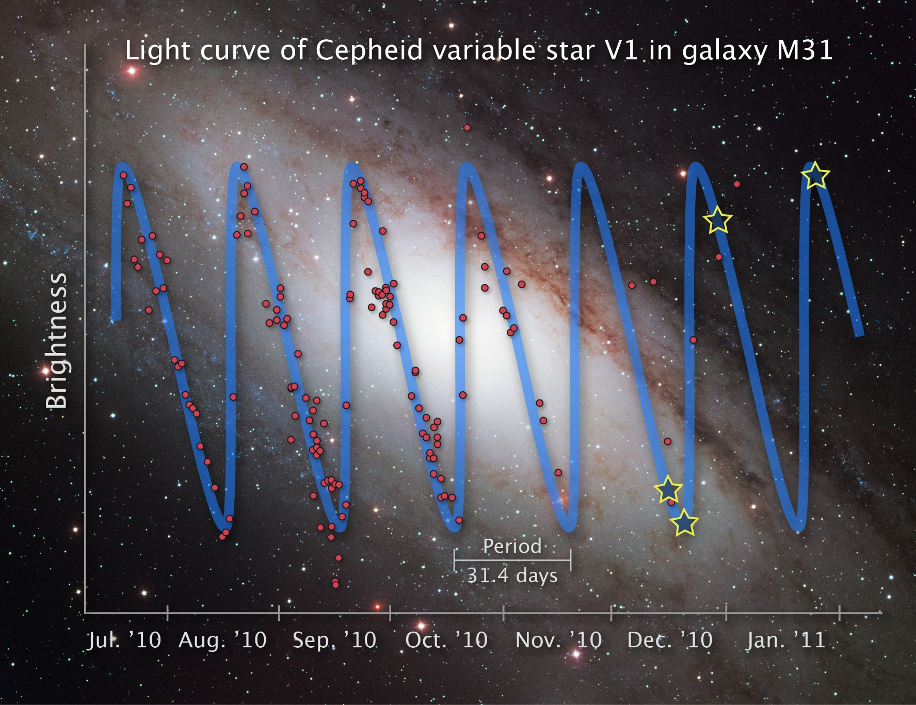
M31
760 kpc
Bild: „opo1115e.jpg“ von NASA, ESA and Z. Levay (STScI). Science Credit: NASA, ESA, the Hubble Heritage Team (STScI/AURA) and the American Association of Variable Star Observers via https://esahubble.org/images/opo1115e/
[CC BY 4.0]

Slide 4
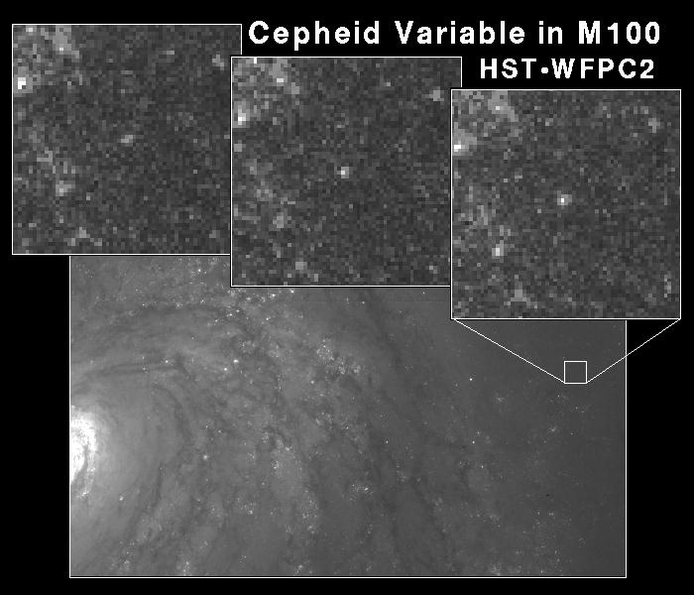
M100
21 Mpc
Bild: Cepheid Variable Star in Galaxy M100 von Dr. Wendy L. Freedman, Observatories of the Carnegie Institution of Washington, and NASA/ESA via https://esahubble.org/images/opo9449a/
[CC BY 4.0]

