Slide 1
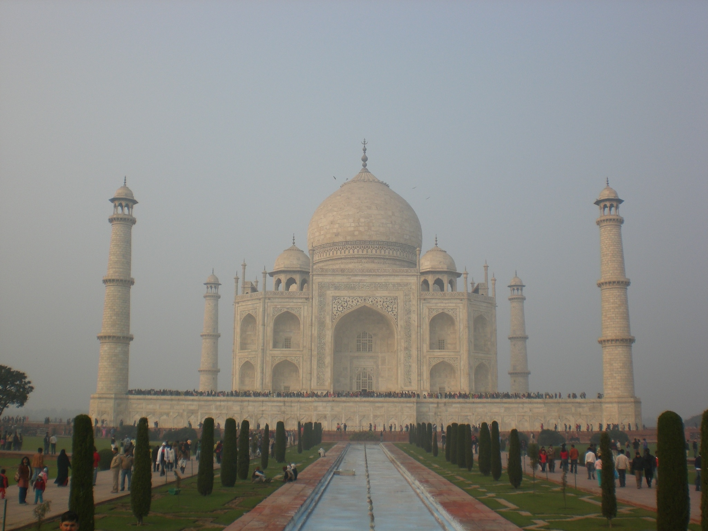
Q&A or Slumdog Millionaire
A storyline project for an advanced level

Slide 2
Setting the scene/Task-cycle
You and your classmates have won the big prize! As the winners in a competition about India, you win a 3-week trip to the “promised land” to find out more about the people, their problems and hopes and about Indian society in general. Together with the accompanying teachers you prepare well in advance - you want to impress the people you are likely to meet and you want to make the best of your trip of a lifetime. If only someone had told you in advance to what use you would have to put your knowledge and skills.... First of all everything goes well - the school that is your home for three weeks is nice, the people are friendly and hospitable and you all learn so much in ever- changing situations. But then disaster strikes: one of the teachers of the school you are staying at is a keen outdoors specialist and invites you on a tour through the fascinating but dangerous Thar Desert in Rajasthan. All of a sudden there are bandits, descendants of the Moguls, who kidnap you and your group at gunpoint. They take you to a secret palace in the middle of the Thar Desert.

Slide 3
Setting the scene/Task-cycle
When you enter the palace you feel like you are in the world of “One Thousand And One Nights”. Everything is so different, scenes of unseen wealth and beauty unfold in front of your wide-open eyes and mouths, but you can feel the danger behind this beauty with every step you take through this oriental scenery. The bandits are a very proud lot and have got some malicious tricks up their sleeves. They are not interested in your money or other worldly goods - they want to play with you - but the stakes are high: win, and you walk; lose, and you will be at their mercy for the rest of your life. Their favourite book is “Slumdog Millionaire” by Vikas Swarup - a novelist they hold in high esteem. They expect any intruder not only to read the novel but to know everything about it and its origins and messages as well.
Don’t be fooled by this. Oh yes, you have learned to deal with novels in class- interpreting them, being creative and presenting the main points! The bandits have other ideas. They will make the tasks even more difficult by slipping in dilemmas and difficult incidents and, being very keen on the correctness of the English language, they set you tasks to prove that you can deal both with the English grammar and vocabulary!!

Slide 4
Tasks
The villains who abducted your group like being entertained in the tradition of their ancestors - when being able to tell a good story used to be a highly esteemed skill. You will be given one or two chapters from the book to present to the villains. You will have to work with a partner or in a team and the way you present it is totally up to you and your team mate. What matters is the quality of your “storytelling” in order to convince the abductors to set you free. Here are the points that should be included:
India – the places where the novel is set/ Indian society
India’s history – now and then – main
features; references in the novel
Religions in India – main features; references in the
novel
The plot/The characters

Slide 5
Tasks
Entertainment and Sport
Language and Grammar
The only freedom they allow you is the mode of presentation and the way you would like to go about your various jobs... So your future is entirely in your own hands

Slide 6
Presentation
Each team or tandem will have to present their work and research in a convincing and entertaining way. The aspects to be dealt with will come from your own discussions within your group and some additional demands from the bandits. At the end of each presentation a well-informed group and happy bandits will guarantee your safety. You all may use your preferred mode of presentation:
Powerpoint presentation
Acting out the scene
Plain storytelling, including various forms of presentations
Interview or dialogue
Interior monologue, etc.
Now you can see how important it was to travel well prepared. If you still have problems, consult your skill pages or your teachers!

Slide 7
The stories
We all wish you good luck because only a lively and captivating performance, courage and inventiveness will guarantee your freedom!!!

